Slide 1



MAVEN MOVIES

Slide 2
OBJECTIVE
To analyze rental trends, identify popular films, and assess store performance using the MavenMovies Sakila database

Slide 3
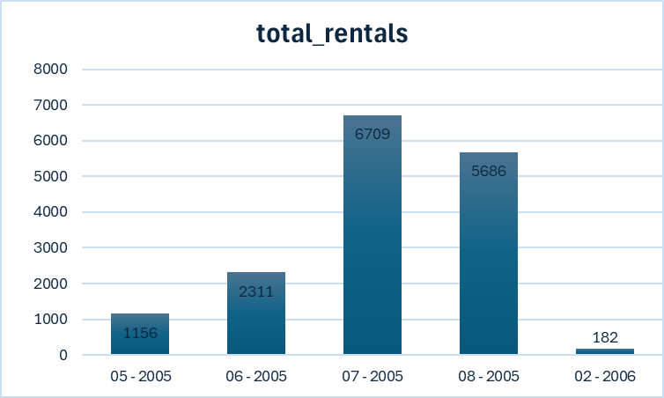

Slide 4
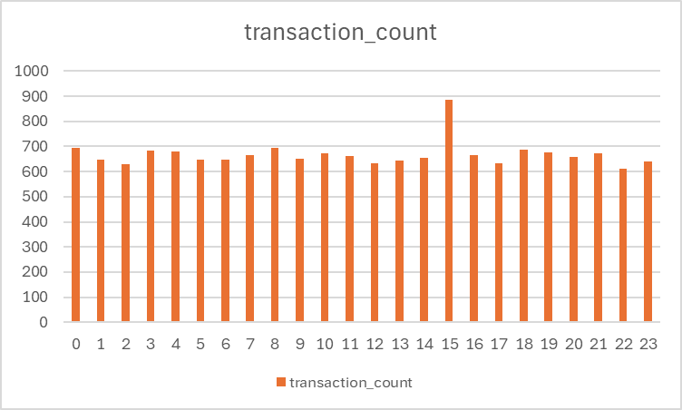

Slide 5
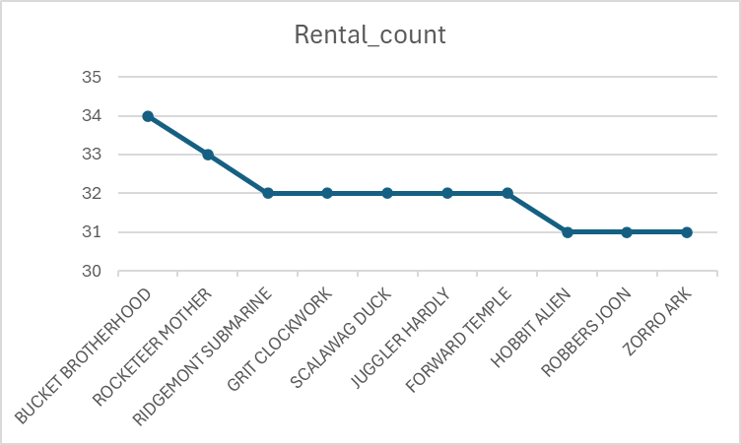

Slide 6
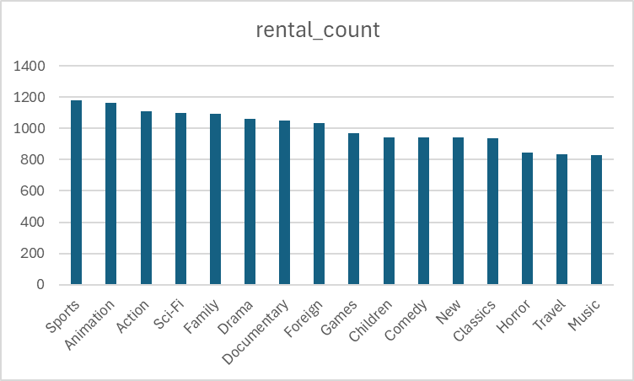

Slide 7
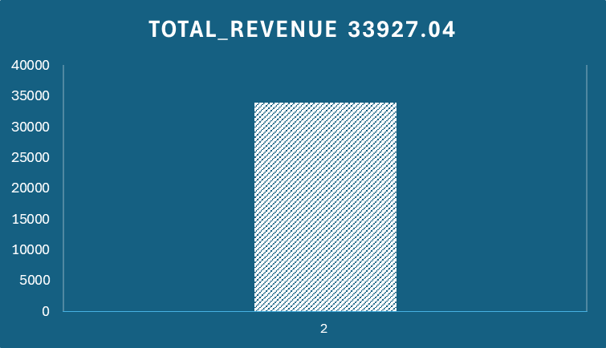

Slide 8
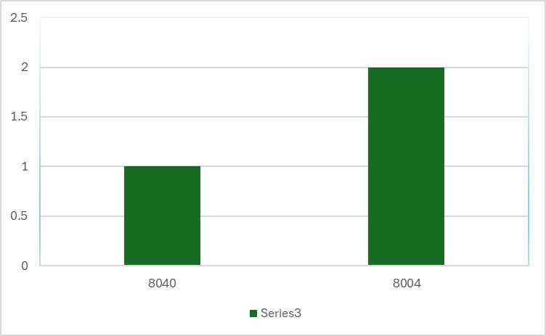

Slide 9
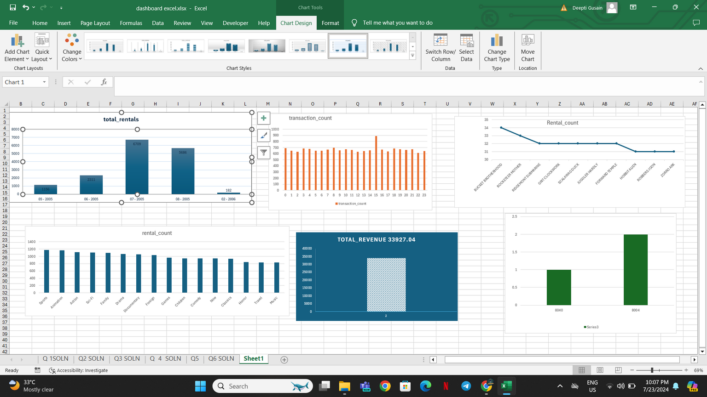

Slide 10
Insights

Slide 11
The trend analysis will help us understand the seasonality in rentals. If we observe higher rentals during certain months, it could indicate peak rental periods which could be due to holidays, weather conditions, or promotional events. Understanding these trends allows for strategic planning in terms of inventory management and marketing efforts

Slide 12
This query highlights the hours in the day when rentals are most frequent. Identifying peak rental hours is crucial for optimizing staffing levels and improving customer service during busy times. For example, if the data shows a peak between 6 PM and 9 PM, more staff can be scheduled during these hours to handle the increased traffic.

Slide 13
This query provides a list of the top 10 most rented films, revealing customer preferences. Understanding which films are most popular can help in making informed decisions about which films to stock more heavily. Popular films can also be featured prominently in marketing materials.

Slide 14
This query identifies the most popular film categories based on the number of rentals. Knowing which categories are most in demand helps in curating the inventory and planning category-specific promotions to attract more customers.

Slide 15
This query identifies which store generates the highest rental revenue. Analyzing the performance of the top-performing store can reveal best practices and strategies that can be implemented across other locations to improve their performance.

Slide 16
This query shows the number of rentals handled by each staff member, highlighting individual performance. Identifying top-performing staff can help in recognizing and rewarding employees, as well as providing training opportunities for others to improve their performance.

Slide 17
Recommendation

Slide 18
Increase marketing efforts and promotions during peak rental months.
Ensure sufficient stock during high-demand periods to avoid stockouts
Schedule more staff during peak rental hours to improve customer service.
Run targeted promotions during off-peak hours to boost rentals.
Stock more copies of the top 10 most rented films.
Create themed promotions and events around popular categories
Study the operational practices of the highest revenue-generating store.
Implement successful strategies from the top store in other locations.
Recognize and reward top-performing staff to boost morale and motivation.

